Slide 1
Improving Modern Techniques of Causal Inference: Finite Sample Performance of ATM and ATO Doubly Robust Estimators, Variance Estimation for ATO Estimators, and Contextualized Tipping Point Sensitivity Analyses for Unmeasured Confounding
Lucy D’Agostino McGowan

Slide 2
Thank you!
Notes:
Committee, Robert, Frank, Cindy, and Peter
All of the faculty – my teachers during my time here and my fellow students – I think this program is really special because while it certainly emphasizes high-level statistical theory, it also fosters community – you have built a space where we can learn together to become successful independent researchers
Family

Slide 3
Is PS weighting inherently flawed?
What if I’ve missed something?
Can I do doubly robust estimation with these better weights?
Notes:
So I think of my work here as following a chronological journey of a researcher – we first sought to answer the question - is propensity score weigthing inherently flawed?
The problems that are thought to exist with weighting methods don’t apply to this new form of weighting called ATO weighting, which I am about to define for you – there have been a lot of papers demonstrating the ways in which weighting methods can break down, be inefficient, etc.
We then derive a doubly robust form for ATO weights and a large-sample variance estimator
Finally, a remaining valid criticism of DR estimation is what if neither model is correct because I’m missing an unmeasured confounder – what do I do then
The structure of this talk, is first I will go over some general background to get everyone on the same page – then I will walk through how we’ve answered each of these questions. After each of the three sections, I will beifly pause to answer and quick clarification questions, and then if you have longer more in depth questions, I will take those for all 3 chapters at the end.

Slide 4
Background

Slide 5

Observational Studies
exposure
outcome

Slide 6
Observational Studies
Randomized Controlled Trials
Treatment
P=0.5
Control
P=0.5

Slide 7

Estimate treatment effect
$$\frac{\sum_{i=1}^{n}{Y_{i}Z_{i}}}{\sum_{i=1}^{n}{Z_{i}}}−\frac{\sum_{i=1}^{n}{Y_{i}\left(1−Z_{i}\right)}}{\sum_{i=1}^{n}{(1−Z_{i})}}$$
Notes:
In a randomized setting, we can just take the the difference between the mean outcome among the treated and the mean outcome among the controls
Here Y is the observed outcome for participant I, Z is the indicator for treatment for participant I (it is 0 or 1), the sum of the Zi is just your treated people, sum of (1-Zi) that is your number of controls

Slide 8
Observational Studies
Treatment
P=0.9
Control
P=0.1

Slide 9

Propensity score
$$e_{i}=P(Z_{i}=1|X)$$
Notes:
In the observational study setting, given that there are no unmeasured confounders, we can use propensity scores to estimate the average treatment effect
the probability that you received treatment given your observed pre-treatment covariates. A lot of times we fit this with a logistic regression

Slide 10

Propensity score
$$e_{i}=P(Z_{i}=1|X)$$
$$w_{i}=f(e_{i}, Z_{i})$$
Notes:
We can then create weights that are some function of the propensity score and the indicator of treatment

Slide 11

Estimate treatment effect
$$\frac{\sum_{i=1}^{n}{Y_{i}Z_{i}w_{i}}}{\sum_{i=1}^{n}{Z_{i}w_{i}}}−\frac{\sum_{i=1}^{n}{Y_{i}\left(1−Z_{i}\right)w_{i}}}{\sum_{i=1}^{n}{\left(1−Z_{i}\right)w_{i}}}$$
Notes:
And incorporate these weights to estimate the treatment effect
- Consistent estimator if the propensity score is correct

Slide 12
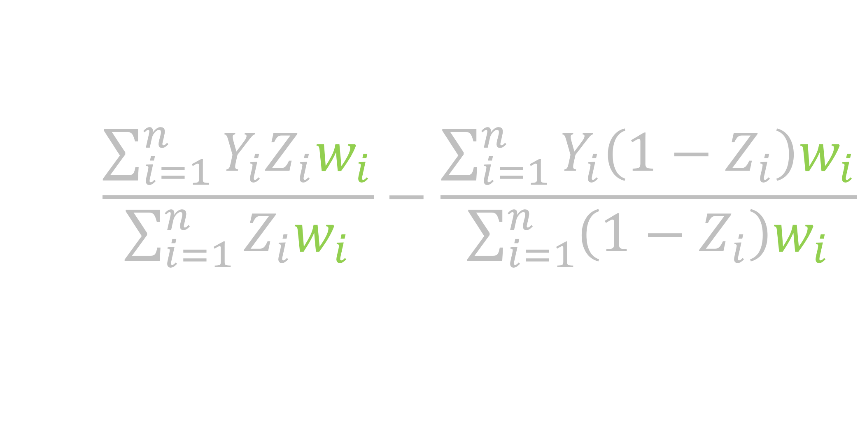
Estimate treatment effect
$$\frac{\sum_{i=1}^{n}{Y_{i}Z_{i}w_{i}}}{\sum_{i=1}^{n}{Z_{i}w_{i}}}−\frac{\sum_{i=1}^{n}{Y_{i}\left(1−Z_{i}\right)w_{i}}}{\sum_{i=1}^{n}{\left(1−Z_{i}\right)w_{i}}}$$
Notes:
And incorporate these weights to estimate the treatment effect
- Consistent estimator if the propensity score is correct

Slide 13
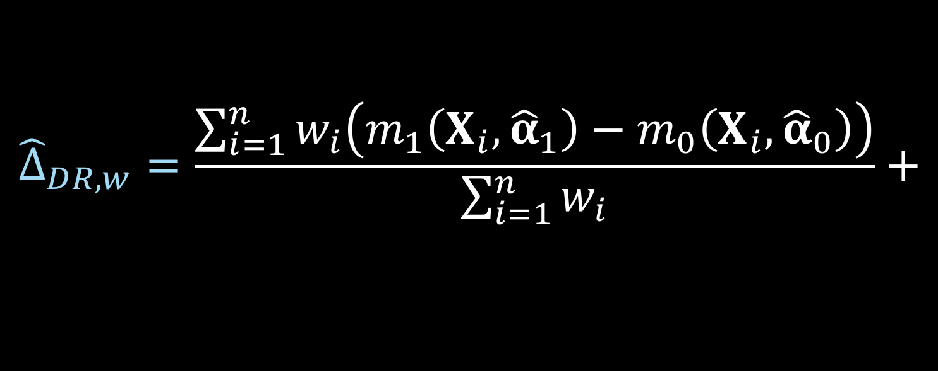


Doubly robust estimator
$${\hat{Δ}}_{DR, w}=\frac{\sum_{i=1}^{n}{w_{i}\left(m_{1}\left(X_{i},{\hat{α}}_{1}\right)−m_{0}\left(X_{i}, {\hat{α}}_{0}\right)\right)}}{\sum_{i=1}^{n}{w_{i}}}+$$
$$\frac{\sum_{i=1}^{n}{w_{i}Z_{i}\left(Y_{i}−m_{1}\left(X_{i}, {\hat{α}}_{1}\right)\right)}}{\sum_{i=1}^{n}{w_{i}}Z_{i}}−$$
$$\frac{\sum_{i=1}^{n}{w_{i}{(1−Z}_{i})\left(Y_{i}−m_{0}\left(X_{i}, {\hat{α}}_{0}\right)\right)}}{\sum_{i=1}^{n}{w_{i}}(1−Z_{i})}$$
Notes:
Consistent if either the propensity score model is correct or outcome

Slide 14
Weighting
ATE Average treatment effect
ATM Average treatment effect among the evenly matchable
ATO Average treatment effect among the overlap population
Notes:
6.30 mintues

Slide 15
Exploring finite-sample bias in propensity score weighting choices

Slide 16
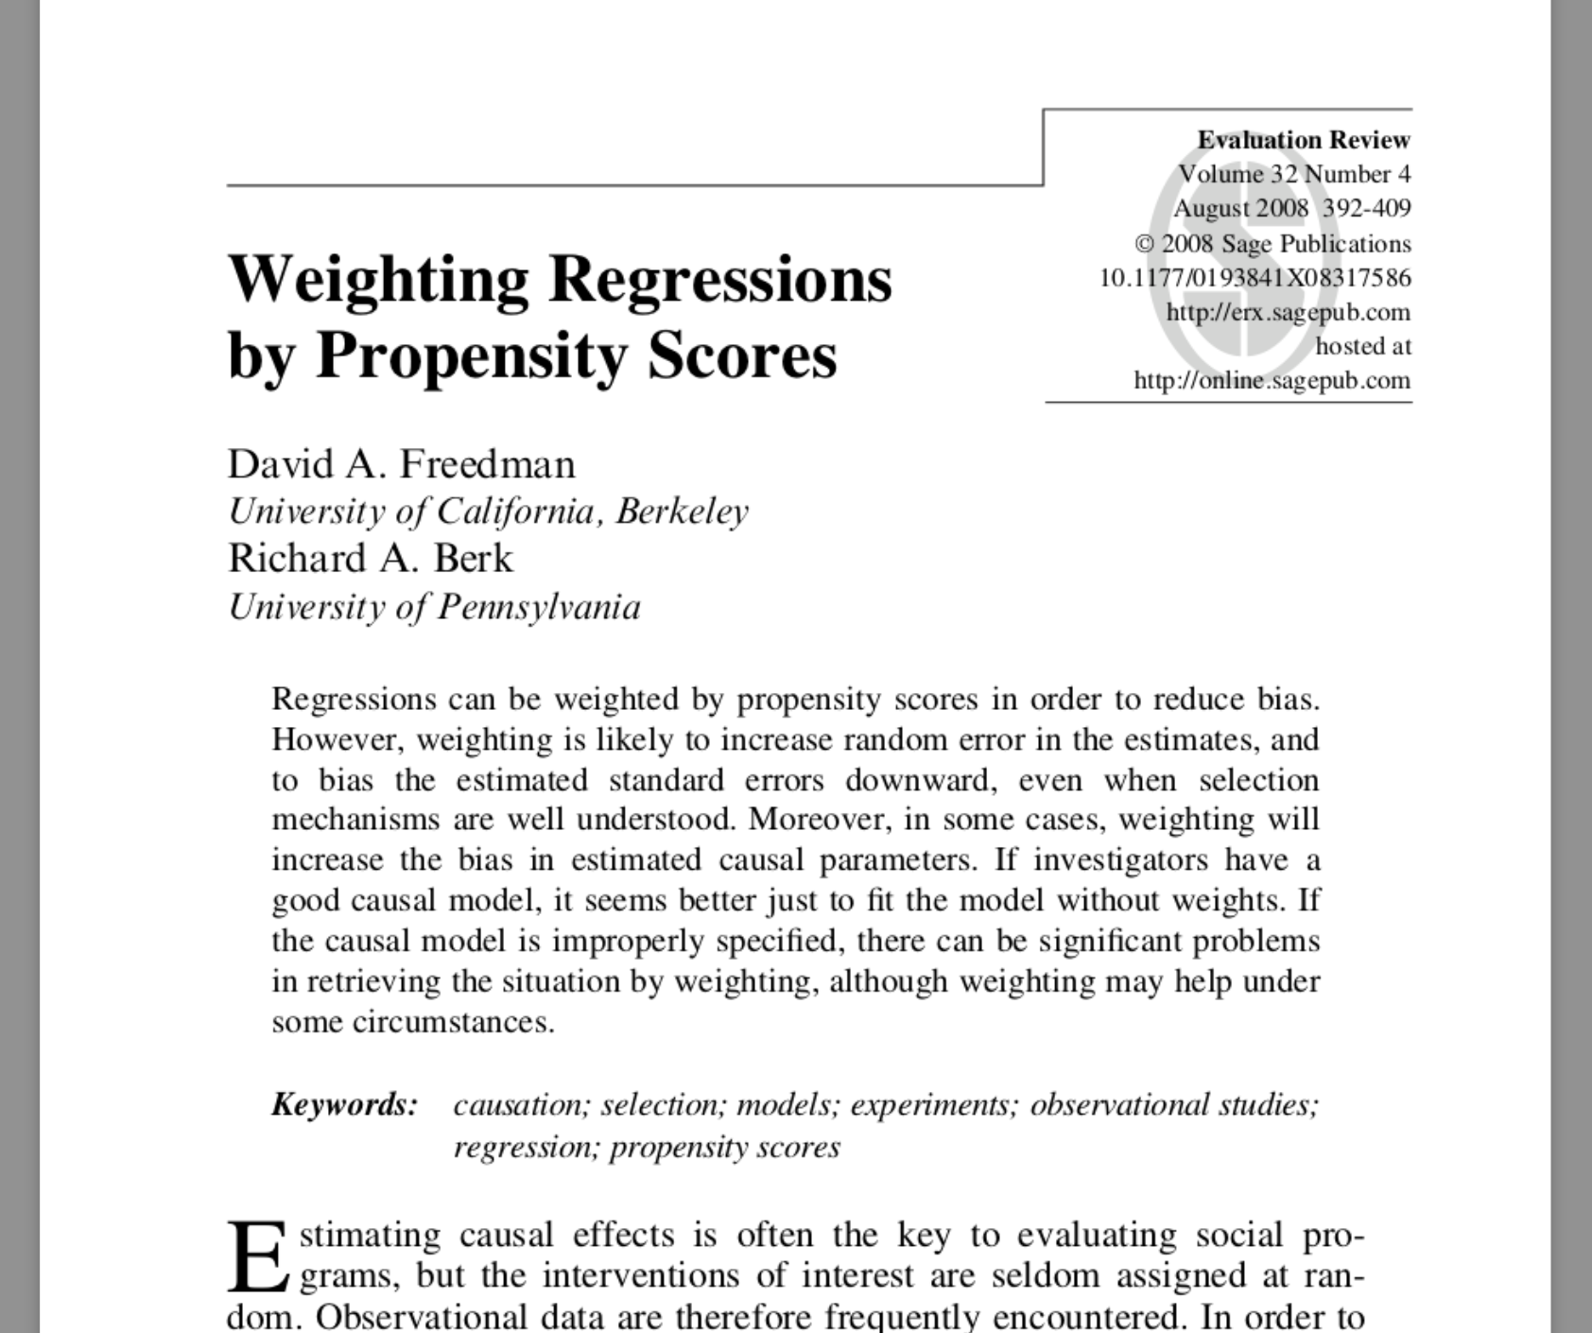
Notes:
* This is one of the seminal papers that made us think that weighting is inherently flawed. We’re going to show that it is not inherently flawed,

Slide 17
Doubly robust estimators
Fit a propensity score model
Fit two outcome models
Use these to estimate an average treatment effect
As long as one is correctly specified, your result will be consistent
Notes:
We’re going to focus on the example where what they do is the doubly robust estimator

Slide 18
Doubly robust estimators
Lunceford and Davidian (2004) derived a consistent estimator for the ATE
Li and Greene (2013) derived a consistent estimator for the ATM
We derive a consistent estimator for the ATO

Slide 19
Propensity score weighting method
The weights used in Freedman & Berk (2008) are estimating ATE
ATE weights can explode
Hypothesize that ATO and ATM weights will perform better
Notes:
These are known to be unstable because the weights can range from 0 to infinity

Slide 20
Fit a misspecified model
Allow the propensity score to be correct
The outcome model is missing a covariate
Notes:
They are intentionally creating a setup that is seemingly friendly to weighting to show that it fails even when it should have been working great

Slide 21

Average treatment effect
$$w_{ATE}=\frac{Z_{i}}{e_{i}}+\frac{{1 −Z}_{i}}{1 −e_{i}}$$

Slide 22
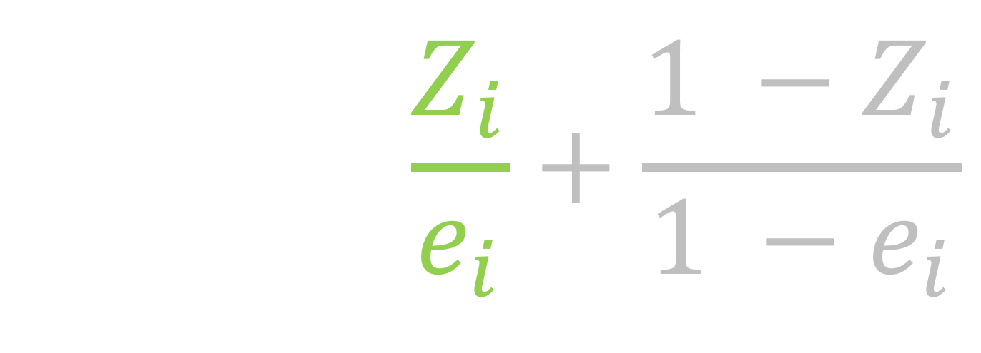
Average treatment effect
$$w_{ATE}=\frac{Z_{i}}{e_{i}}+\frac{{1 −Z}_{i}}{1 −e_{i}}$$

Slide 23
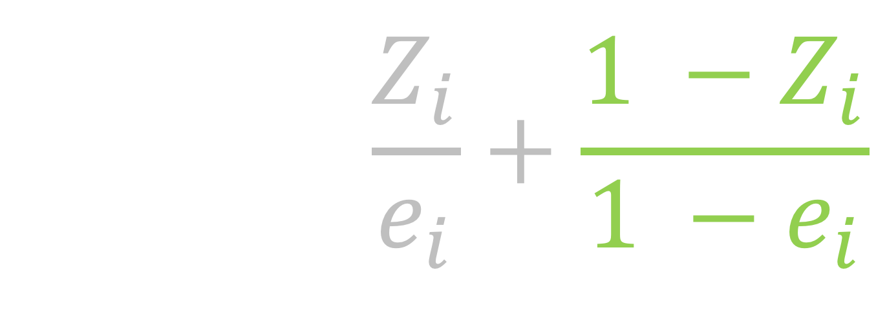
Average treatment effect
$$w_{ATE}=\frac{Z_{i}}{e_{i}}+\frac{{1 −Z}_{i}}{1 −e_{i}}$$

Slide 24
treatment
control

Slide 25
trt
control
Notes:
The dark portion, the grey, are the propensity scores the top part of the mirrored histogram is the treated population and the bottom, the upside-down histogram is the control population. Then the green represents the weighted propensity scores for the treated and the blue is the weighted propensity scores for the controls.
Add a legend - maybe don't need all of the hatches

Slide 26
trt
control
151
Notes:
The dark portion, the grey, are the propensity scores the top part of the mirrored histogram is the treated population and the bottom, the upside-down histogram is the control population. Then the green represents the weighted propensity scores for the treated and the blue is the weighted propensity scores for the controls.
- Frequency counts for a sudo population based on the weights
_click_ This guy at the far end has a propensity score greater than .99, and therefore ends up accounting for 151 people in the sudo cohort

Slide 27

Average treatment effect among the evenly matchable
$$w_{ATM}=\frac{min\left\{e_{i}, 1−e_{i}\right\}}{{e_{i}Z}_{i}+(1 −e_{i})(1−Z_{i})}$$
Li & Greene (2013)
Notes:
Here, the ATM depends on some distance measure d to determine whether each participant is deemed “evenly matchable”, Md=1. The less prevalent exposure in any region of the covariate space, as defined by d, is matchable in the sense that they would readily find mates in a 1:1 within-caliper matching without replacement.
This estimand was defined by Laurie in her dissertation a last year.

Slide 28
treatment
control
1
Notes:
Population: based on the table 1, the exposed and unexposed in the weighted Table 1 will look like each other, but they will look different than the overall cohort – they will look like if you had done a matched cohort (1:1 matching)
This one person now is only representing 1 person in the sudo cohort, meanwhile the 20 treated people right above are each account for 1/20th of a person in the sudo cohort

Slide 29

Average treatment effect among the overlap population
$$w_{ATO}=\left(1−e_{i}\right)Z_{i}+ e_{i}(1−Z_{i})$$
Li et al (2016)

Slide 30
treatment
control
Notes:
Population: will look a lot like a Table 1 from a 1:1 matched trial, but shifts a bit to improve the variance

Slide 31
ATE
ATM
AT0

Slide 32
ATE
ATM
AT0

Slide 33
ATE
ATM
AT0

Slide 34
Freedman & Berk Simulation

Slide 35
x₁
x₂
z
y

Slide 36
1
x₁
x₂
0.25
2
0.75
1
z
1
y

Slide 37
1
x₁
x₂
0.25
2
0.75
1
z
1
y

Slide 38
1
x₁
x₂
0.25
2
0.75
1
z
1
y

Slide 39
1
x₁
x₂
0.25
2
0.75
1
z
1
y

Slide 40
1
x₁
x₂
0.25
2
0.75
1
z
1
y

Slide 41
Propensity score model
x₁
x₂
z

Slide 42
Outcome model
x₁
x₂
z
y

Slide 43
treatment
ctrl

Slide 44
n = 1000
Notes:
At n = 1000, Freedman and Berk report a bias of 0.13 and we replicate this, we observing a bias of 0.14. Even when n is 10,000, the result is still biased. So they of course were correct, these weights do lead to bias in finite samples.

Slide 45
Notes:
However it turns out to be less of a story about weighting in general, and more of a story about these particular weights.

Slide 47
Standard errors

Slide 48
Outcome model
x₁
x₂
z
y

Slide 49
Notes:
We replicate what Freedman and Berk show, that this difference in the true standard error of these estimates is 0.12.

Slide 50
Notes:
Correct-correct
Minimum variance unbiased estimator

Slide 52
Recap
Replicated the finite-sample bias seen by Freedman and Berk using the ATE weights
ATM and ATO weights had improved finite-sample properties
The variance for the ATO and ATM is preferable to that of the ATE

Slide 53
Notes:
17 minutes

Slide 54
Doubly robust and large sample variance estimator for overlap weights

Slide 55
Derive doubly robust estimator for ATO Derive large sample variance for the ATO Simulate to compare to conventional methods
Notes:
In fact the derivation itself was pretty straightforward and not that interesting, but the proof of the doubly robust property is really what we’ve done

Slide 56
We want to use a propensity score model and also adjust the outcome model

Slide 57
How to
Doubly robust estimator
Can’t we just fit a weighted generalized linear model Y ~ Z + X?
Notes:
Fit a single weighted generalized linear model, with the Xs included – this is commonly what I have seen done in the literature – under the continuous case, using a GLM with a identity link, this is essentially a doubly robust estimator
Use a doubly robust estimator where we fit two models, one among the treated and one among the controls and combine them using the weights

Slide 58
How to
Doubly robust estimator
Can’t we just fit a weighted generalized linear model Y ~ Z + X?
But what about the variance?
Pull from the GLM (naïve)?
Robust standard errors? (naïve robust)
Notes:
But what about the variance? Again if we are fitting a single model, we can pull the variances directly from the GLM or we can use robust standard errors, however the robust standard errors from a GLM won’t incorporate the fact that the propensity scores are not fixed. Alternatively, we can use the doubly robust estimator and fit an updated large-sample variance that incorporates the propensity score model

Slide 59
Williamson 2013
“
…ignoring the estimation of the propensity score in the calculation of the variance leads to the erroneous conclusion that the IPTW treatment effect estimator has the same variance as an unadjusted estimator; thus, it is important to use a variance estimator that correctly takes into account the estimation of the propensity score.
”

Slide 60

ATO DR estimator
$${\hat{Δ}}_{DR, ATO}={\hat{δ}}_{1}+{\hat{δ}}_{2}−{\hat{δ}}_{3}$$
Notes:
We can write the doubly robust estimator for the ATO in 3 equations, delta 1, delta2 and delta 3

Slide 61
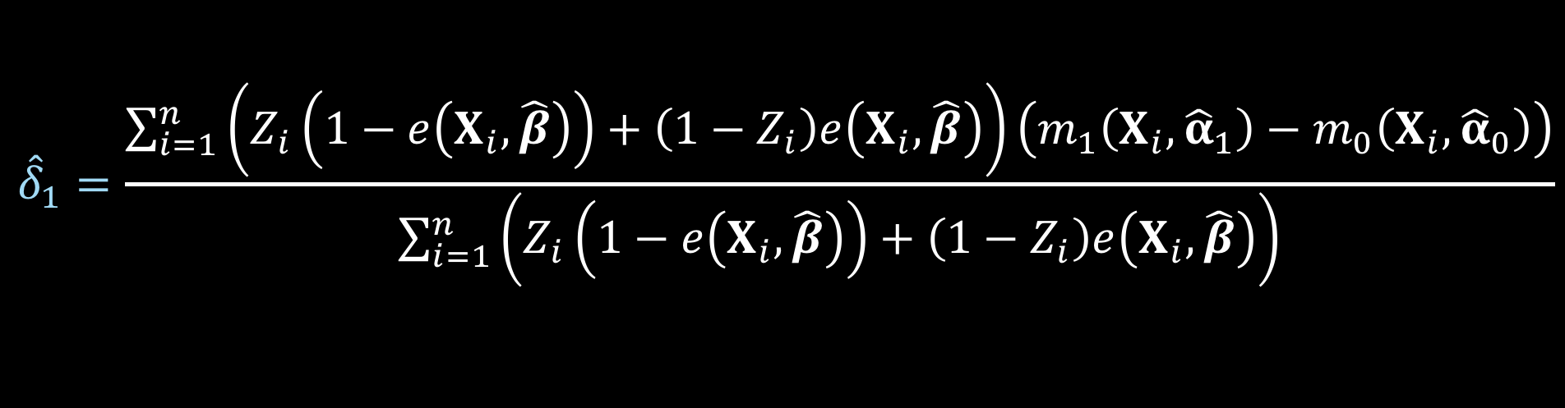
ATO DR estimator
$${\hat{Δ}}_{DR, ATO}={\hat{δ}}_{1}+{\hat{δ}}_{2}−{\hat{δ}}_{3}$$
$${\hat{δ}}_{1}=\frac{\sum_{i=1}^{n}{\left(Z_{i}\left(1−e\left(X_{i},\hat{β}\right)\right)+\left(1−Z_{i}\right)e\left(X_{i},\hat{β}\right)\right)\left(m_{1}\left(X_{i},{\hat{α}}_{1}\right)−m_{0}\left(X_{i}, {\hat{α}}_{0}\right)\right)}}{\sum_{i=1}^{n}{\left(Z_{i}\left(1−e\left(X_{i},\hat{β}\right)\right)+\left(1−Z_{i}\right)e\left(X_{i},\hat{β}\right)\right)}}$$
Notes:
Here is delta 1

Slide 62
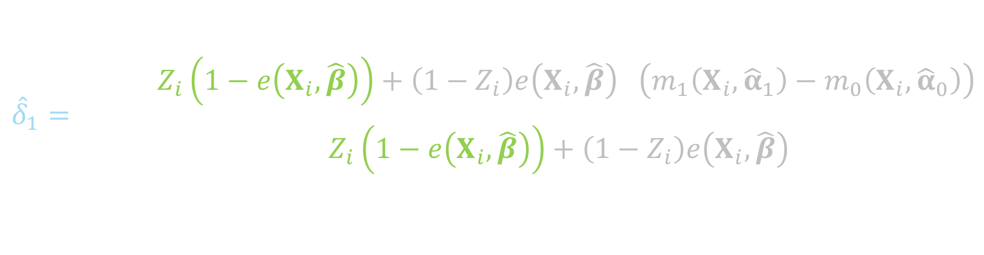
ATO DR estimator
$${\hat{Δ}}_{DR, ATO}={\hat{δ}}_{1}+{\hat{δ}}_{2}−{\hat{δ}}_{3}$$
$${\hat{δ}}_{1}=\frac{\sum_{i=1}^{n}{\left(Z_{i}\left(1−e\left(X_{i},\hat{β}\right)\right)+\left(1−Z_{i}\right)e\left(X_{i},\hat{β}\right)\right)\left(m_{1}\left(X_{i},{\hat{α}}_{1}\right)−m_{0}\left(X_{i}, {\hat{α}}_{0}\right)\right)}}{\sum_{i=1}^{n}{\left(Z_{i}\left(1−e\left(X_{i},\hat{β}\right)\right)+\left(1−Z_{i}\right)e\left(X_{i},\hat{β}\right)\right)}}$$
Notes:
This will be weighted by 1 minus the propensity score for the treated

Slide 63
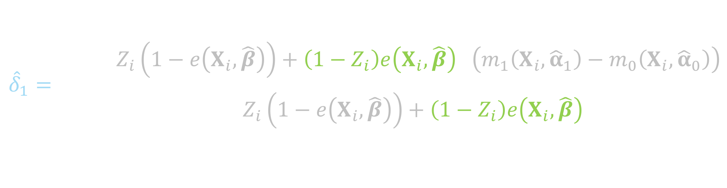
ATO DR estimator
$${\hat{Δ}}_{DR, ATO}={\hat{δ}}_{1}+{\hat{δ}}_{2}−{\hat{δ}}_{3}$$
$${\hat{δ}}_{1}=\frac{\sum_{i=1}^{n}{\left(Z_{i}\left(1−e\left(X_{i},\hat{β}\right)\right)+\left(1−Z_{i}\right)e\left(X_{i},\hat{β}\right)\right)\left(m_{1}\left(X_{i},{\hat{α}}_{1}\right)−m_{0}\left(X_{i}, {\hat{α}}_{0}\right)\right)}}{\sum_{i=1}^{n}{\left(Z_{i}\left(1−e\left(X_{i},\hat{β}\right)\right)+\left(1−Z_{i}\right)e\left(X_{i},\hat{β}\right)\right)}}$$
Notes:
And the propensity score for the controls

Slide 64
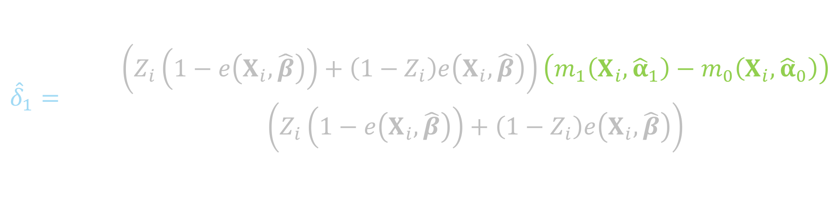
ATO DR estimator
$${\hat{Δ}}_{DR, ATO}={\hat{δ}}_{1}+{\hat{δ}}_{2}−{\hat{δ}}_{3}$$
$${\hat{δ}}_{1}=\frac{\sum_{i=1}^{n}{\left(Z_{i}\left(1−e\left(X_{i},\hat{β}\right)\right)+\left(1−Z_{i}\right)e\left(X_{i},\hat{β}\right)\right)\left(m_{1}\left(X_{i},{\hat{α}}_{1}\right)−m_{0}\left(X_{i}, {\hat{α}}_{0}\right)\right)}}{\sum_{i=1}^{n}{\left(Z_{i}\left(1−e\left(X_{i},\hat{β}\right)\right)+\left(1−Z_{i}\right)e\left(X_{i},\hat{β}\right)\right)}}$$
Notes:
Here is the difference between the Y predicted among the treated and the Y predicted among the controls

Slide 65
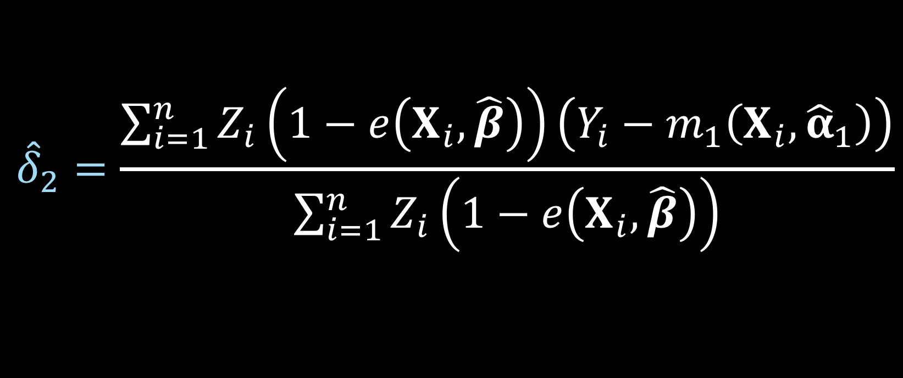
ATO DR estimator
$${\hat{Δ}}_{DR, ATO}={\hat{δ}}_{1}+{\hat{δ}}_{2}−{\hat{δ}}_{3}$$
$${\hat{δ}}_{2}=\frac{\sum_{i=1}^{n}{Z_{i}\left(1−e\left(X_{i},\hat{β}\right)\right)\left(Y_{i}−m_{1}\left(X_{i},{\hat{α}}_{1}\right)\right)}}{\sum_{i=1}^{n}{Z_{i}\left(1−e\left(X_{i},\hat{β}\right)\right)}}$$
Notes:
Here is delta 2

Slide 66
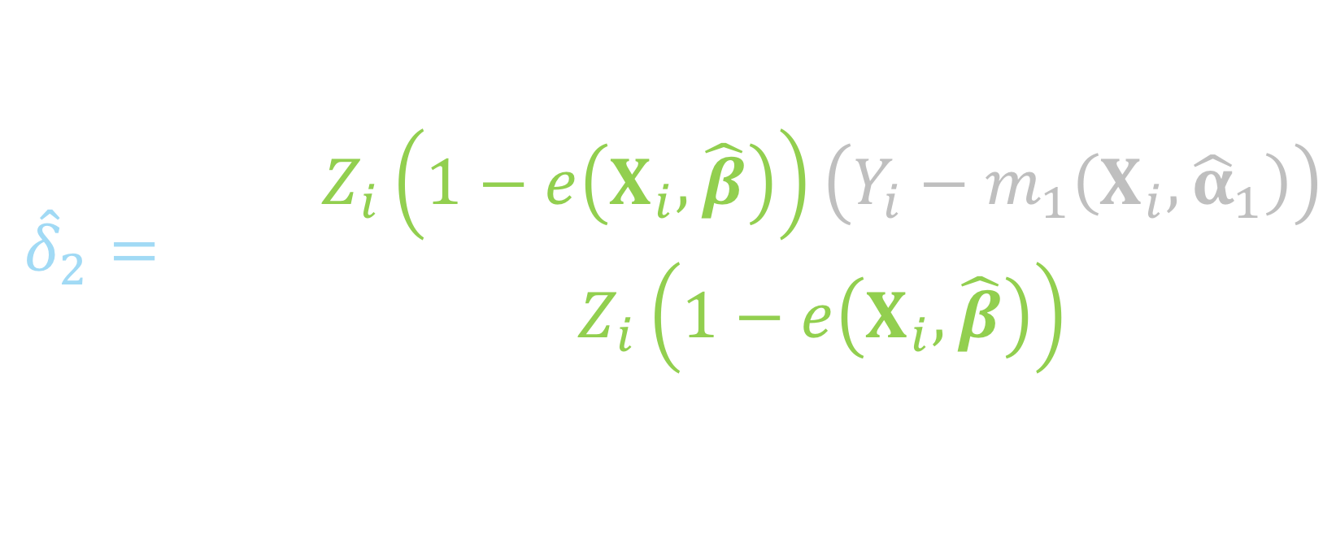
ATO DR estimator
$${\hat{Δ}}_{DR, ATO}={\hat{δ}}_{1}+{\hat{δ}}_{2}−{\hat{δ}}_{3}$$
$${\hat{δ}}_{2}=\frac{\sum_{i=1}^{n}{Z_{i}\left(1−e\left(X_{i},\hat{β}\right)\right)\left(Y_{i}−m_{1}\left(X_{i},{\hat{α}}_{1}\right)\right)}}{\sum_{i=1}^{n}{Z_{i}\left(1−e\left(X_{i},\hat{β}\right)\right)}}$$
Notes:
Notice this is just among the treated, so if the subject i is in the control group, this will be zero, since Zi will be 0

Slide 67
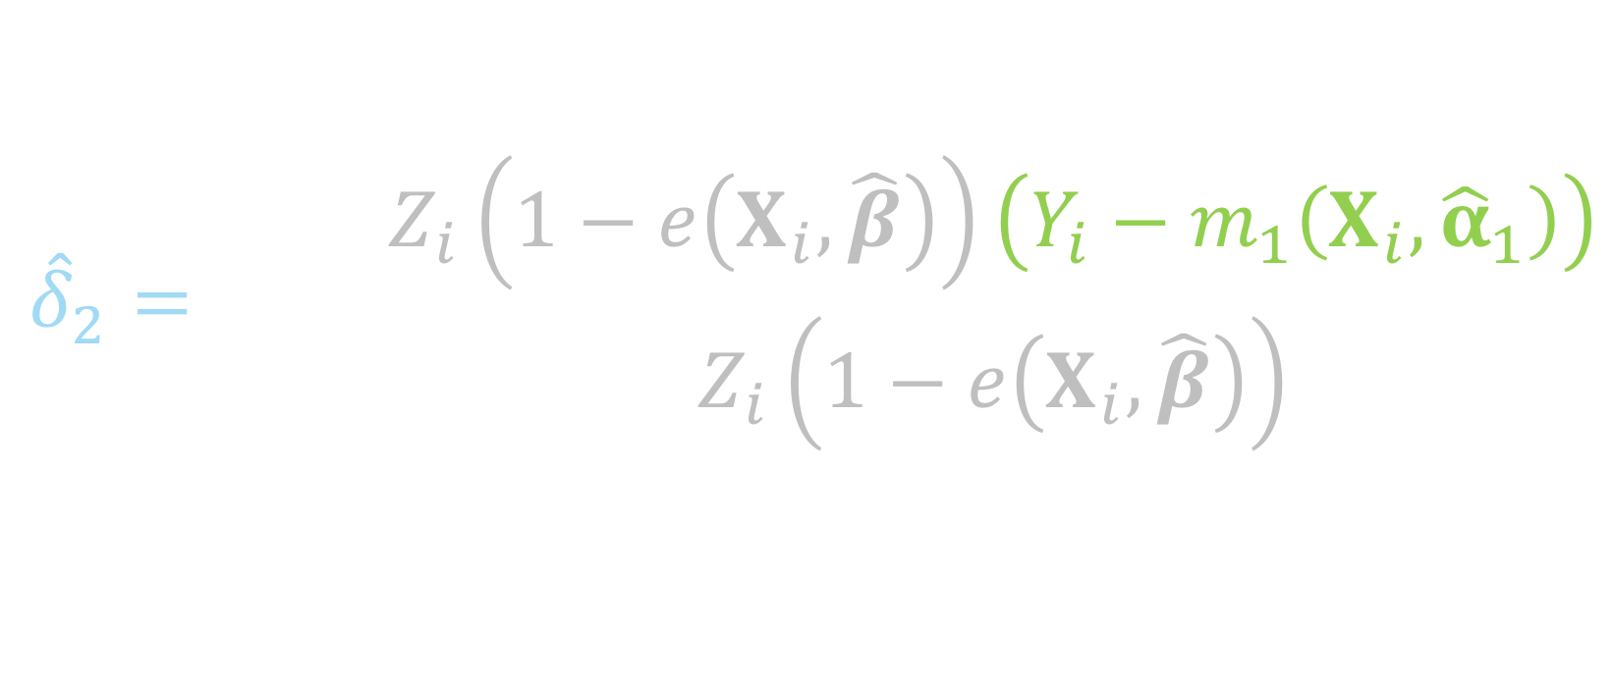
ATO DR estimator
$${\hat{Δ}}_{DR, ATO}={\hat{δ}}_{1}+{\hat{δ}}_{2}−{\hat{δ}}_{3}$$
$${\hat{δ}}_{2}=\frac{\sum_{i=1}^{n}{Z_{i}\left(1−e\left(X_{i},\hat{β}\right)\right)\left(Y_{i}−m_{1}\left(X_{i},{\hat{α}}_{1}\right)\right)}}{\sum_{i=1}^{n}{Z_{i}\left(1−e\left(X_{i},\hat{β}\right)\right)}}$$
Notes:
This piece is essentially the residual between the observed Y among the treated and the predicted Y among the treated

Slide 68
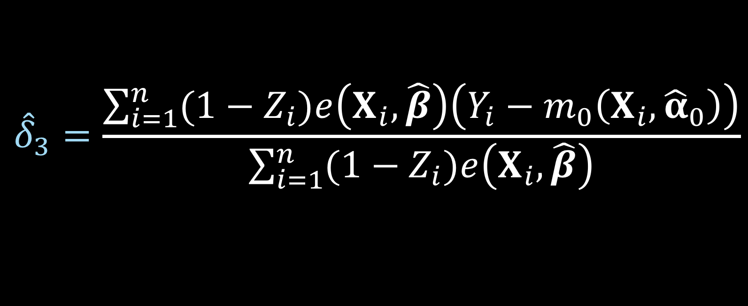
ATO DR estimator
$${\hat{Δ}}_{DR, ATO}={\hat{δ}}_{1}+{\hat{δ}}_{2}−{\hat{δ}}_{3}$$
$${\hat{δ}}_{3}=\frac{\sum_{i=1}^{n}{{(1−Z}_{i})e\left(X_{i},\hat{β}\right)\left(Y_{i}−m_{0}\left(X_{i},{\hat{α}}_{0}\right)\right)}}{\sum_{i=1}^{n}{{(1−Z}_{i})e\left(X_{i},\hat{β}\right)}}$$
Notes:
Here is delta 3

Slide 69
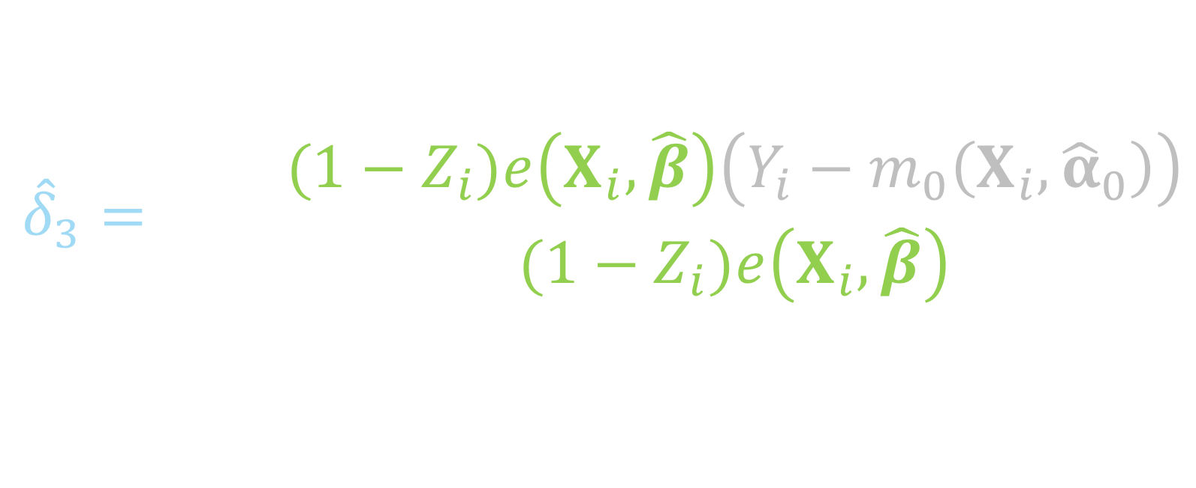
ATO DR estimator
$${\hat{Δ}}_{DR, ATO}={\hat{δ}}_{1}+{\hat{δ}}_{2}−{\hat{δ}}_{3}$$
$${\hat{δ}}_{3}=\frac{\sum_{i=1}^{n}{{(1−Z}_{i})e\left(X_{i},\hat{β}\right)\left(Y_{i}−m_{0}\left(X_{i},{\hat{α}}_{0}\right)\right)}}{\sum_{i=1}^{n}{{(1−Z}_{i})e\left(X_{i},\hat{β}\right)}}$$
Notes:
This summation is just among the controls, if the participant is in the treated group, 1 – Zi will be 0

Slide 70
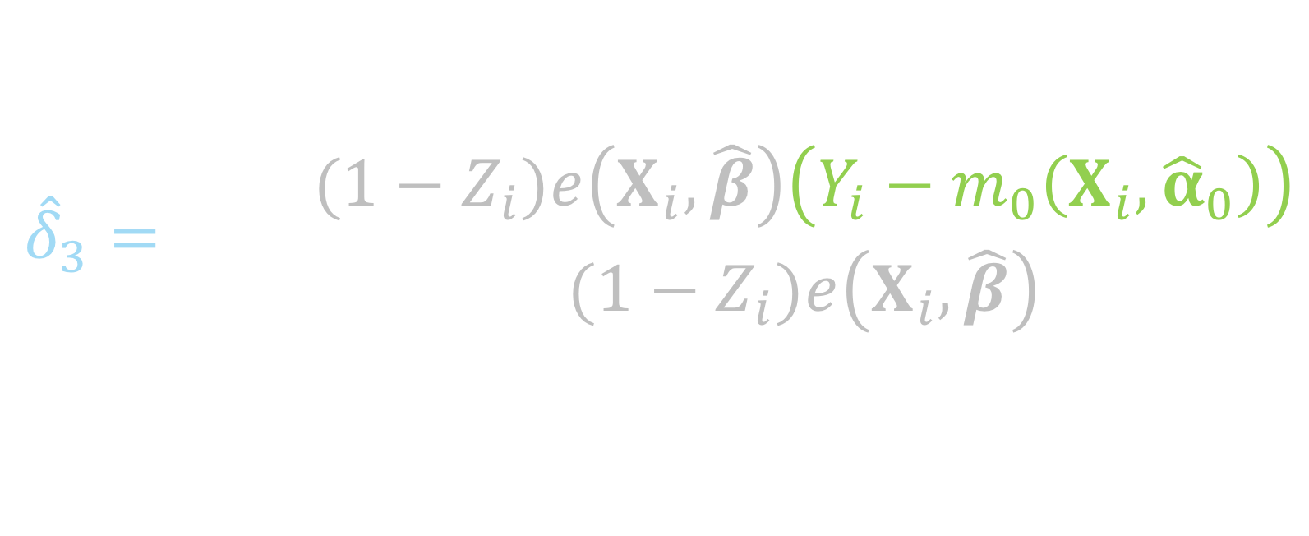
ATO DR estimator
$${\hat{Δ}}_{DR, ATO}={\hat{δ}}_{1}+{\hat{δ}}_{2}−{\hat{δ}}_{3}$$
$${\hat{δ}}_{3}=\frac{\sum_{i=1}^{n}{{(1−Z}_{i})e\left(X_{i},\hat{β}\right)\left(Y_{i}−m_{0}\left(X_{i},{\hat{α}}_{0}\right)\right)}}{\sum_{i=1}^{n}{{(1−Z}_{i})e\left(X_{i},\hat{β}\right)}}$$
Notes:
And this is the residual of the observed y among the controls and the predicted y, fit among the controls

Slide 71


ATO DR estimator
$$u\left(θ\right)=\left(\begin{matrix}(m_{1}\left(X, α_{1}\right)−m_{0}\left(X, α_{0}\right)−δ_{1})(Z\left(1−e\left(X,β\right)\right)+\left(1−Z\right)e\left(X,β\right)) \\ \left(Y−m_{1}\left(X, α_{1}\right)−δ_{2}\right)Z(1−e\left(X,β\right)) \\ \begin{aligned}\left(Y−m_{0}\left(X, α_{0}\right)−δ_{3}\right)\left(1−Z\right)e\left(X, β\right) \\ \left(Y−m_{1}\left(X,α_{1}\right)\right)ZX \\ \left(Y−m_{0}\left(X,α_{0}\right)\right)\left(1−Z\right)X \\ X\left(Z−e\left(X,β\right)\right)\end{aligned}\end{matrix}\right)$$
$$θ={\left(δ_{1}, δ_{2},δ_{3},α_{1}^{T},α_{0}^{T},β^{T}\right)}^{T}$$
Notes:
Again this can be solved by simultaneously solving these estimating equations. Note here that this technically will only be correct if both the outcome model AND the propensity score model are correctly specified.

Slide 72
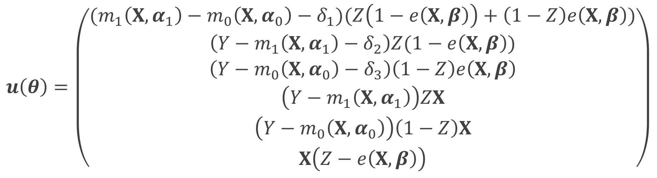
ATO DR estimator
$$u\left(θ\right)=\left(\begin{matrix}(m_{1}\left(X, α_{1}\right)−m_{0}\left(X, α_{0}\right)−δ_{1})(Z\left(1−e\left(X,β\right)\right)+\left(1−Z\right)e\left(X,β\right)) \\ \left(Y−m_{1}\left(X, α_{1}\right)−δ_{2}\right)Z(1−e\left(X,β\right)) \\ \begin{aligned}\left(Y−m_{0}\left(X, α_{0}\right)−δ_{3}\right)\left(1−Z\right)e\left(X, β\right) \\ \left(Y−m_{1}\left(X,α_{1}\right)\right)ZX \\ \left(Y−m_{0}\left(X,α_{0}\right)\right)\left(1−Z\right)X \\ X\left(Z−e\left(X,β\right)\right)\end{aligned}\end{matrix}\right)$$
$$θ={\left(δ_{1}, δ_{2},δ_{3},α_{1}^{T},α_{0}^{T},β^{T}\right)}^{T}$$
Notes:
This is more complicated than the large-sample variance that we derived for the ATO IPW estimator because now we have more parameters to solve for, rather than just mu1, mu0 and beta, we now have delta 1 2 and 3, and alpha 1 and 0 from the outcome models

Slide 73

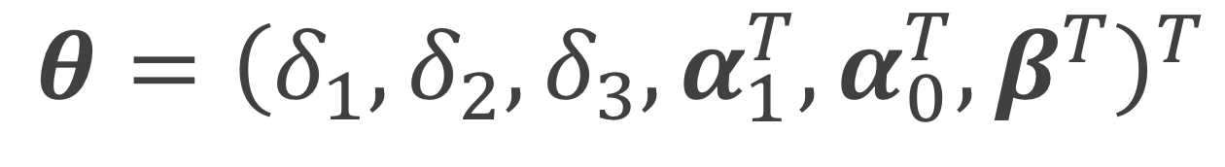
ATO DR estimator
$$u\left(θ\right)=\left(\begin{matrix}(m_{1}\left(X, α_{1}\right)−m_{0}\left(X, α_{0}\right)−δ_{1})(Z\left(1−e\left(X,β\right)\right)+\left(1−Z\right)e\left(X,β\right)) \\ \left(Y−m_{1}\left(X, α_{1}\right)−δ_{2}\right)Z(1−e\left(X,β\right)) \\ \begin{aligned}\left(Y−m_{0}\left(X, α_{0}\right)−δ_{3}\right)\left(1−Z\right)e\left(X, β\right) \\ \left(Y−m_{1}\left(X,α_{1}\right)\right)ZX \\ \left(Y−m_{0}\left(X,α_{0}\right)\right)\left(1−Z\right)X \\ X\left(Z−e\left(X,β\right)\right)\end{aligned}\end{matrix}\right)$$
$$θ={\left(δ_{1}, δ_{2},δ_{3},α_{1}^{T},α_{0}^{T},β^{T}\right)}^{T}$$
Notes:
These first 3 lines are the estimating equations that make up the 3 parts of the doubly robust equation we just went through

Slide 74
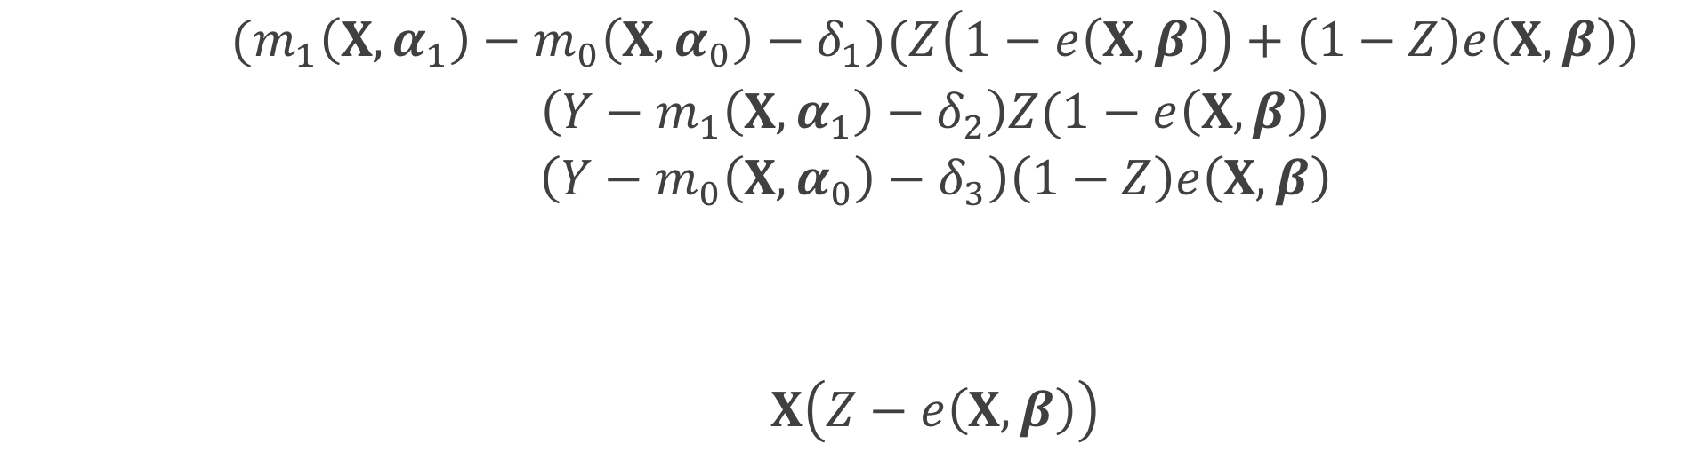
ATO DR estimator
$$u\left(θ\right)=\left(\begin{matrix}(m_{1}\left(X, α_{1}\right)−m_{0}\left(X, α_{0}\right)−δ_{1})(Z\left(1−e\left(X,β\right)\right)+\left(1−Z\right)e\left(X,β\right)) \\ \left(Y−m_{1}\left(X, α_{1}\right)−δ_{2}\right)Z(1−e\left(X,β\right)) \\ \begin{aligned}\left(Y−m_{0}\left(X, α_{0}\right)−δ_{3}\right)\left(1−Z\right)e\left(X, β\right) \\ \left(Y−m_{1}\left(X,α_{1}\right)\right)ZX \\ \left(Y−m_{0}\left(X,α_{0}\right)\right)\left(1−Z\right)X \\ X\left(Z−e\left(X,β\right)\right)\end{aligned}\end{matrix}\right)$$
$$θ={\left(δ_{1}, δ_{2},δ_{3},α_{1}^{T},α_{0}^{T},β^{T}\right)}^{T}$$
Notes:
These two are the estimating equations for fitting the outcome models, the top is for the outcome model among the treated, the bottom is the outcome model among the controls

Slide 75
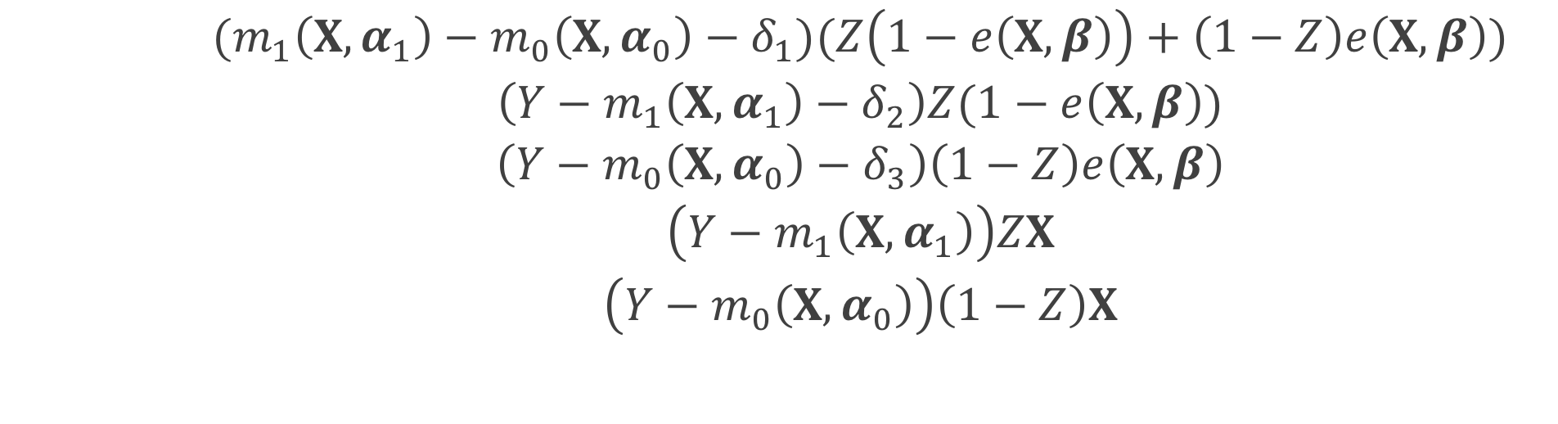
ATO DR estimator
$$u\left(θ\right)=\left(\begin{matrix}(m_{1}\left(X, α_{1}\right)−m_{0}\left(X, α_{0}\right)−δ_{1})(Z\left(1−e\left(X,β\right)\right)+\left(1−Z\right)e\left(X,β\right)) \\ \left(Y−m_{1}\left(X, α_{1}\right)−δ_{2}\right)Z(1−e\left(X,β\right)) \\ \begin{aligned}\left(Y−m_{0}\left(X, α_{0}\right)−δ_{3}\right)\left(1−Z\right)e\left(X, β\right) \\ \left(Y−m_{1}\left(X,α_{1}\right)\right)ZX \\ \left(Y−m_{0}\left(X,α_{0}\right)\right)\left(1−Z\right)X \\ X\left(Z−e\left(X,β\right)\right)\end{aligned}\end{matrix}\right)$$
$$θ={\left(δ_{1}, δ_{2},δ_{3},α_{1}^{T},α_{0}^{T},β^{T}\right)}^{T}$$
Notes:
This final equation accounts for the propensity score model

Slide 76

ATO estimator
$$0=\sum_{i=1}^{n}{u_{i}\left(θ\right)}$$
$$θ={\left(δ_{1}, δ_{2},δ_{3},α_{1}^{T},α_{0}^{T},β^{T}\right)}^{T}$$
Notes:
we can estimate the propensity score and the treatment effect simultaneously in one step by solving the following estimating equations with respect to theta

Slide 77

M-Estimation
$$\sqrt{n}\left(\hat{θ}−θ\right)\underset{→}{d}N(0, A^{−1}BA^{−T})$$
Notes:
Since these estimating equations are unbiased, U of theta is an example of an M-estimator. The asymptotic distribution of an M estimator is the following.
the negative T is just inverse transpose

Slide 78

Sandwich estimator
$$A^{−1}BA^{−T}$$

Slide 79

Sandwich estimator
$$A^{−1}BA^{−T}$$
$$A=−E\left[\frac{∂u\left(θ\right)}{∂θ}\right]$$
Notes:
A is the model-based estimate, B is the “robust” estimate of the information (the variance of the score function)

Slide 80

Sandwich estimator
$$A^{−1}BA^{−T}$$
$B=E\left[u\left(θ\right)u{\left(θ\right)}^{T}\right]$

Slide 81

Sandwich estimator
$$\hat{var}\left(\hat{θ}\right)=\frac{1}{n}{{\hat{A}}_{n}}^{−1}{\hat{B}}_{n}{{\hat{A}}_{n}}^{−T}$$
Notes:
We can replace the expectations by the sample average to get an approximate large sample variance

Slide 82
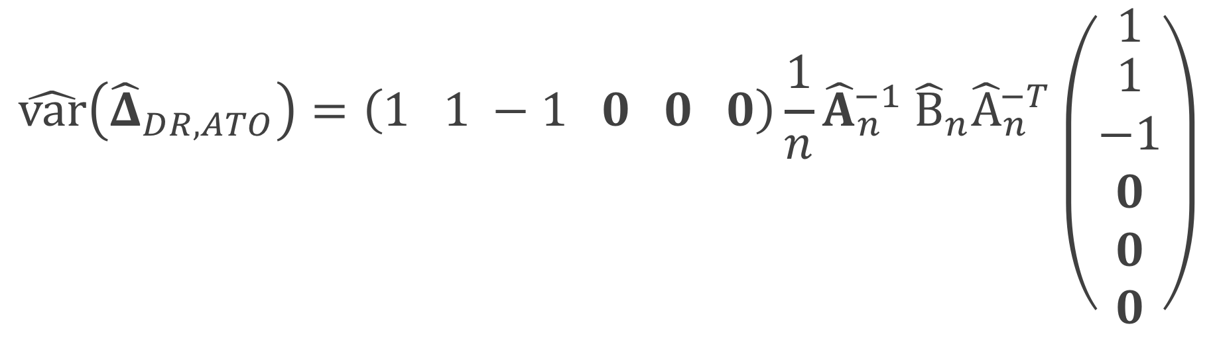
ATO DR estimator
$${\hat{Δ}}_{DR, ATO}={\hat{δ}}_{1}+{\hat{δ}}_{2}−{\hat{δ}}_{3}$$
$$\hat{var}\left({\hat{Δ}}_{DR, ATO}\right)=\left(1 1 −1 0 0 0\right){\frac{1}{n}\hat{A}}_{n}^{−1} {\hat{B}}_{n}{\hat{A}}_{n}^{−T}\left({1 \atop \begin{aligned}1 \\ −1 \\ 0 \\ 0 \\ 0\end{aligned}}\right)$$
Notes:
Because we are estimating delta 1 plus delta 2 minus delta 3, after we estimate our sandwich estimator

Slide 83

ATO DR estimator
$${\hat{Δ}}_{DR, ATO}={\hat{δ}}_{1}+{\hat{δ}}_{2}−{\hat{δ}}_{3}$$
$$\hat{var}\left({\hat{Δ}}_{DR, ATO}\right)=\left(1 1 −1 0 0 0\right){\frac{1}{n}\hat{A}}_{n}^{−1} {\hat{B}}_{n}{\hat{A}}_{n}^{−T}\left({1 \atop \begin{aligned}1 \\ −1 \\ 0 \\ 0 \\ 0\end{aligned}}\right)$$
Notes:
This will be our variance estimator where

Slide 84
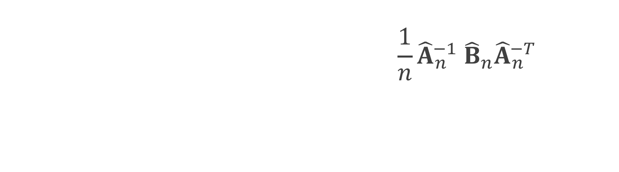
ATO DR estimator
$${\hat{Δ}}_{DR, ATO}={\hat{δ}}_{1}+{\hat{δ}}_{2}−{\hat{δ}}_{3}$$
$$\hat{var}\left({\hat{Δ}}_{DR, ATO}\right)=\left(1 1 −1 0 0 0\right){\frac{1}{n}\hat{A}}_{n}^{−1} {\hat{B}}_{n}{\hat{A}}_{n}^{−T}\left({1 \atop \begin{aligned}1 \\ −1 \\ 0 \\ 0 \\ 0\end{aligned}}\right)$$
Notes:
We will multiply by the vector 1 1 -1 with the remaining entries 0 on both sides

Slide 85
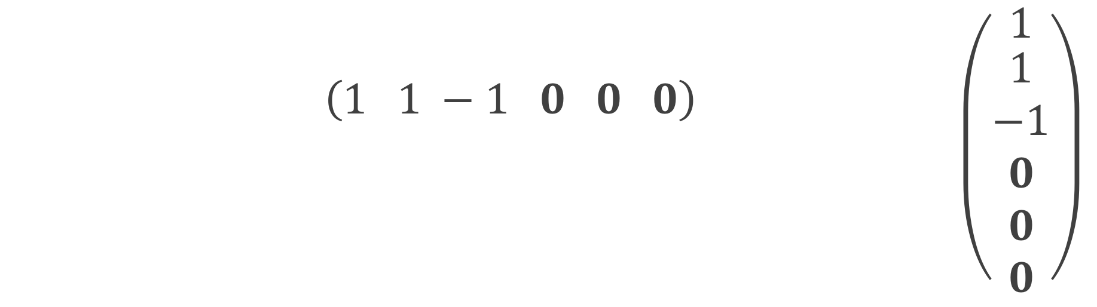
ATO DR estimator
$${\hat{Δ}}_{DR, ATO}={\hat{δ}}_{1}+{\hat{δ}}_{2}−{\hat{δ}}_{3}$$
$$\hat{var}\left({\hat{Δ}}_{DR, ATO}\right)=\left(1 1 −1 0 0 0\right){\frac{1}{n}\hat{A}}_{n}^{−1} {\hat{B}}_{n}{\hat{A}}_{n}^{−T}\left({1 \atop \begin{aligned}1 \\ −1 \\ 0 \\ 0 \\ 0\end{aligned}}\right)$$
Notes:
We multiply by our estimated sandwich estimator where we've plugged in our sample averages for the expectations

Slide 86
Freedman & Berk* Simulation

Slide 87
1
x₁
x₂
0.25
3
0.75
1
z
1
y
Notes:
We made this even stronger to make it even more challenging for our variance estimator

Slide 88
correct-correct correct-wrong wrong-correct wrong-wrong
Notes:
We have 4 settings, and in fact we actually have 6, because we observe 3 different settings in the wrong-wrong case

Slide 89
correct-correct correct-wrong wrong-correct wrong-wrong

Slide 90
correct-correct correct-wrong wrong-correct wrong-wrong

Slide 91
correct-correct correct-wrong wrong-correct wrong-wrong

Slide 92
correct-correct correct-wrong wrong-correct wrong-wrong
extreme
moderate
slight

Slide 93
x₁
x₂
z
y

Slide 94
bias ratio estimated se / true se RMSE 95% coverage

Slide 95
bias ratio estimated se / true se RMSE 95% coverage

Slide 96
correct-correct

Slide 97
correct-correct

Slide 98
PS
outcome
correct-wrong

Slide 99
PS
outcome
correct-wrong

Slide 100
PS
outcome
wrong-correct
Notes:
TODO

Slide 101
PS
outcome
wrong-correct

Slide 102
extreme
wrong-wrong

Slide 103
extreme
wrong-wrong

Slide 104
moderate
wrong-wrong

Slide 105
slight
wrong-wrong
Notes:
Even here, in a less extreme case (we’ve made the size of the unmeasured confounder pretty small) you still see by the time N = 5000, the bias fully takes over the variance, pulling the coverage to 0.

Slide 106
Recap
Derived the DR estimator and large sample variance for ATO
Compared to conventional methods
When the outcome model is correctly specified, robust standard errors obtained from a generalized linear model perform well, otherwise our large-sample variance is preferred
If a confounder is completely left out, we need alternative methods to adjust for the bias

Slide 107
Notes:
16 minutes

Slide 108
Contextualized Tipping Point Sensitivity Analyses for Unmeasured Confounding

Slide 109
Motivation
Review of 90 observational studies JAMA, NEJM, and AJE
41 mentioned the issue of unmeasured confounding as a limitation
4 performed a quantitative sensitivity analysis
Notes:
We conducted a review of 90 observational studies with statistically significant findings published in 2015 in the Journal of the American Medical Association, the New England Journal of Medicine, and the American Journal of Epidemiology. 41 (45.6%) mentioning the issue of unmeasured confounding as a limitation and only 4 (4.4%) performing a quantitative sensitivity analysis.

Slide 110

Tipping point analyses
what will tip our confidence bound to cross 1
Notes:
We’ve formally defined these tipping point analyses for binary and continuous unmeasured confounders

Slide 111
R package
tipr
tip_with_binary()
tip_with_continuous()
Notes:
And we’ve created an R-package to calculate them

Slide 112
Right Heart Catheterization Data
Connors et al (1996)
Notes:
This dataset is assessing the effectiveness of right heart catheterization (RHC) in the initial care of critically ill patients.
Publically available

Slide 113
Right heart catheterization
Got content experts to confirm they had all important covariates
Assessed how sensitive the model is to the removal of some covariates
They did a real quantified sensitivity analysis

Slide 114
Right heart catheterization
Got content experts to confirm they had all important covariates
Assessed how sensitive the model is to the removal of some covariates
They did a real quantified sensitivity analysis

Slide 115
Right heart catheterization
Got content experts to confirm they had all important covariates
Assessed how sensitive the model is to the removal of some covariates
They perform a quantified sensitivity analysis

Slide 116
Right heart catheterization
“
A true relative hazard of 1.0 could be misrepresented as 1.21 if a missing covariate that simultaneously increased the risk of death 3-fold and the probability of RHC 3-fold was not accounted for.
”
Notes:
We like this sensitivity analysis, but practicioners get stuck here _click_ – it may be difficult to determine how likely you are to see a covariate such as this. _click_ Another difficulty is this 3 actually has a bit behind it to unpack. What does this actually mean for a real unmeasured confounder? Well if it is binary, it means

Slide 117
Right heart catheterization
“
A true relative hazard of 1.0 could be misrepresented as 1.21 if a missing covariate that simultaneously increased the risk of death 3-fold and the probability of RHC 3-fold (with a prevalence among those with RHC of 0.175 and a prevalence among those without of 0.058) was not accounted for.
”
Notes:
That the prevalence of the unmeasured confounder among those with RHC is _click_ 0.175 and the _click_ prevalence among those without is _click_ 0.058.

Slide 118
Right heart catheterization
“
A true relative hazard of 1.0 could be misrepresented as 1.21 if a missing covariate that simultaneously increased the risk of death 3-fold and the probability of RHC 3-fold (with a prevalence among those with RHC of 0.175 and a prevalence among those without of 0.058) was not accounted for.
”
Notes:
So 0.175 divided by 0.058 will be 3, and will tip the analysis if the risk of death is 3, but there are other pairs of prevalences that will also have an effect of three that would tip the analysis at a different risk of death

Slide 119
Right heart catheterization
“
A true relative hazard of 1.0 could be misrepresented as 1.21 if a missing covariate that simultaneously increased the risk of death 1.35-fold and the probability of RHC 3-fold (with a prevalence among those with RHC of 1 and a prevalence among those without of 1/3) was not accounted for.
”
Notes:
For example if we change the prevalence among those with RHC to _click_ 1 and among those without to _click__click_ 1/3, this still has a relative risk of 3, because 1 over 1/3 is 3,

Slide 120
Right heart catheterization
“
A true relative hazard of 1.0 could be misrepresented as 1.21 if a missing covariate that simultaneously increased the risk of death 1.35-fold and the probability of RHC 3-fold (with a prevalence among those with RHC of 1 and a prevalence among those without of 1/3) was not accounted for.
”
Notes:
however now we would only need a risk of death of _click_ 1.35 in order to tip our analysis. Thinking about which of these scenarios is more plausible is important

Slide 121
E-value
$$E−value=LB_{obs}+\sqrt{LB_{obs}×(LB_{obs}−1)}$$
Ding and VanderWeele (2017)
Notes:
Vanderweele and Ding’s E-value answers a similar question as this quantified sensitivity analysis, it is the point that minimizes the strength of association, on the risk ratio scale, that an unmeasured confounder would need to have with both the exposure and outcome, conditional on the measured covariates, to explain away an observed exposure-outcome association. Again this is certainly one way to look at the analysis, but can be difficult contextualize without more information.

Slide 122
Right heart catheterization
“
A true relative hazard of 1.0 could be misrepresented as 1.21 if a missing covariate that simultaneously increased the risk of death 1.71-fold and the probability of RHC 1.71-fold was not accounted for.
”
Notes:
Using Vanderweele’s E-value, we’d update the statement to change the needed risk of death and the increase in probability of RHC to 1.71-fold. Again, this 1.71 has a bit to unpack, so if this were an unmeasured binary confounder, this would mean

Slide 123
Right heart catheterization
“
A true relative hazard of 1.0 could be misrepresented as 1.21 if a missing covariate that simultaneously increased the risk of death 1.71-fold and the probability of RHC 1.71-fold (with a prevalence among those with RHC of 1 and a prevalence among those without of 0.58) was not accounted for.
”
Notes:
The prevalence of the unmeasured confounder among those with RHC is _click_ 1 and among those without is _click_ 0.58. Our work is to create a simplified way to explore these sensitivity analyses as tipping points, as well as to contextualize them

Slide 124

Adjusted E-value
$$E−{value}_{adj}=\frac{LB_{obs}}{LB_{adj}}+\sqrt{\frac{LB_{obs}}{LB_{adj}}×\left(\frac{LB_{obs}}{LB_{adj}}−1\right)}$$
Notes:
In addition, we’ve used similar methodology to create an adjusted e-value, where we allow you to input the value you are trying to adjust to, rather than always setting the adjusted limiting bound to one. I will demonstrate soon how we can use this with our observed covariates

Slide 125
Right Heart Catheterization data
We chose 20 covariates for demonstration purposes
demographics
comorbidities
physiological measurements
diagnosis categories
APACHE score
SUPPORT (probability of surviving 2 months)
DNR status on day 1
Connors et al (1996)
Notes:
We chose 20 covariates to include for demonstration purposes
Demographics
Comorbidities
Physiological measurements
Diagnosis categories
APACHE score
SUPPORT model estimate of the probability of surviving 2 months
DNR status on day 1

Slide 126
Right Heart Catheterization data
Fit a propensity score model
Use ATO weights
Fit weighted cox model for 30 day survival

Slide 127
Notes:
I’m going to spend a minute on this plot -- this is a plot we’ve come up with that we’re calling an ”observed bias plot” the light blue shaded region shows the confidence interval for the observed exposure – outcome effect with all covariates included in the analysis, so here the effect between RHC and 30 day survival, in our case it is about (1.11 to 1.37). The blue line down the center is the observed point estimate, in this case it is a hazard ratio around 1.24. Each black line is the exposure-outcome effect that would have been observed had the covariate indicated not been observed. For example this top one here _click_ is the observed effect between RHC and 30 day survival if we had not observed DNR status on day 1 _click_. The purple stars represent the “adjusted E-values” These represent what the E-value would be if the *only* unmeasured confounder that were missing is the one that is dropped. So this E-value here _click_ represents what the E-value would be if DNR status on day 1 were the only missing covariate. This gives some contextualization to the E-value, allowing you to imagine it in the context of your observed covariates

Slide 128
Notes:
We also include additional values at the bottom _click_ where we can observe what happens if we leave out groups of variables, such as Labs or physiological measurements. This begins to get at the question “what if we are missing a lot of unmeasured confounders”. We then also plot what an unmeasured confounder that would tip the analysis at the Lower Bound and at the point estimate would look like, along with the associated E-value.

Slide 129
Notes:
Given the observed lower bound of 1.11, the associated E-value is 1.46. Examining Observed bias plot we can add some context to this value. The only associated E-value close to this is that for DNR status on day 1. This implies that we would need to be missing an additional independent covariate akin to DNR status on day 1 in order to tip our analysis. Even dropping all physiological measurements would not reach an E-value great enough to tip this study to inconclusive.

Slide 130
Recap
Rearranged sensitivity analysis formulas to create a tipping point analysis
Created tipr, an R package to perform these analysis
Adjusted the E-value to allow it to be contextualized
Demonstrated how to contextualize these analyses

Slide 131
Q&A
Notes:
13 minutes

Slide 132
References
Austin, Peter C. 2009. “Balance diagnostics for comparing the distribution of baseline covariates between treatment groups in propensity-score matched samples.” Statistics in Medicine 28 (25): 3083–3107.
Austin, Peter C, and Elizabeth A Stuart. 2015. “Moving towards best practice when using inverse probability of treatment weighting (IPTW) using the propensity score to estimate causal treatment effects in observational studies.” Statistics in Medicine 34 (28): 3661–79.
Bang, Heejung, and James M Robins. 2005. “Doubly Robust Estimation in Missing Data and Causal Inference Models.” Biometrics 61 (4): 962–73.
Belle, G. van. 2011. Statistical Rules of Thumb. Wiley Series in Probability and Statistics. Wiley. https://books.google.com/books?id=UaEL-HI6v2YC.
Bross, IDJ. 1966. “Spurious effects from an extraneous variable.” Journal of Chronic Diseases.
Brumback, Babette A, Miguel A Hernán, Sebastien J P A Haneuse, and James M Robins. 2004. “Sensitivity analyses for unmeasured confounding assuming a marginal structural model for repeated measures.” Statistics in Medicine 23 (5): 749–67.
Busso, Matias, John DiNardo, and Justin McCrary. 2009. “Finite sample properties of semiparametric estimators of average treatment effects.” Forthcoming in the Journal of Business and Economic Statistics.

Slide 133
References
———. 2014. “New Evidence on the Finite Sample Properties of Propensity Score Reweighting and Matching Estimators.” Review of Economics and Statistics 96 (5): 885–97.
Connors, A F, T Speroff, N V Dawson, and C Thomas. 1996. “The effectiveness of right heart catheterization in the initial care of critically III patients.” Jama.
Cornfield, J, W Haenszel, E C Hammond, A M Lilienfeld, M B Shimkin, and E L Wynder. 1959. “Smoking and lung cancer: recent evidence and a discussion of some questions.” Journal of the National Cancer Institute 22 (1): 173–203.
Crump, R K, V J Hotz, G W Imbens, and O A Mitnik. 2009. “Dealing with limited overlap in estimation of average treatment effects.” Biometrika 96 (1): 187–99.
Ding, Peng, and Tyler J VanderWeele. 2016. “Sensitivity Analysis Without Assumptions.” Epidemiology (Cambridge, Mass.) 27 (3): 368–77.
D’Agostino, R B. 1998. “Propensity score methods for bias reduction in the comparison of a treatment to a non-randomized control group.” Statistics in Medicine 17 (19): 2265–81.
Freedman, David A, and Richard A Berk. 2008. “Weighting regressions by propensity scores.” Evaluation Review 32 (4): 392–409.

Slide 134
References
Funk, Michele Jonsson, Daniel Westreich, Chris Wiesen, Til Stürmer, M Alan Brookhart, and Marie Davidian. 2011. “Doubly Robust Estimation of Causal Effects.” American Journal of Epidemiology 173 (7): 761–67.
Greenland, Sander. 1998. “The sensitivity of a sensitivity analysis.” 1997 Proceedings of the Biometrics Section American Statistica Association, 19–21.
———. 2001. “Sensitivity Analysis, Monte Carlo Risk Analysis, and Bayesian Uncertainty Assessment.” Risk Analysis 21 (4): 579–84.
———. 2003. “The Impact of Prior Distributions for Uncontrolled Confounding and Response Bias.” Journal of the American Statistical Association 98 (461): 47–54.
———. 2005. “Multiple-bias modelling for analysis of observational data.” Journal of the Royal Statistical Society: Series A (Statistics in Society) 168 (2): 267–306.
Groenwold, Rolf H H, Anna M M Van Deursen, Arno W Hoes, and Eelko Hak. 2008. “Poor Quality of Reporting Confounding Bias in Observational Intervention Studies: A Systematic Review.” Annals of Epidemiology 18 (10): 746–51.
Groenwold, Rolf H H, Frank Vries, Anthonius Boer, Wiebe R Pestman, Frans H Rutten, Arno W Hoes, and Olaf H Klungel. 2011. “Balance measures for propensity score methods: a clinical example on beta-agonist use and the risk of myocardial infarction.” Pharmacoepidemiology and Drug Safety 20 (11): 1130–7.

Slide 135
References
Hansen, Ben B, and Mark M Fredrickson. 2014. “Omitted Variable Sensitivity Analysis with the Annotated Love Plot.” Society for Research on Educational Effectiveness.
Hosman, C A, B B Hansen, and P W Holland. 2010. “The Sensitivity of Linear Regression Coefficients’ Confidence Limits to the Omission of a Confounder.” The Annals of Applied Statistics.
Hsu, Jesse Y, and Dylan S Small. 2013. “Calibrating Sensitivity Analyses to Observed Covariates in Observational Studies.” Biometrics 69 (4): 803–11.
Imai, K, G King, and E A Stuart. 2008. “Misunderstandings between experimentalists and observationalists about causal inference.” Journal of the Royal Statistical Society ….
Imbens, Guido W, and Donald B Rubin. 2015. Causal Inference in Statistics, Social, and Biomedical Sciences. Cambridge University Press.
Imbens, Guido W, and Jeffrey M Wooldridge. 2009. “Recent Developments in the Econometrics of Program Evaluation.” Journal of Economic Literature 47 (1): 5–86.
Joffe, Marshall M, Thomas R Ten Have, Harold I Feldman, and Stephen E Kimmel. 2004. “Model Selection, Confounder
Control, and Marginal Structural Models.” The American Statistician 58 (4): 272–79.

Slide 136
References
Li, Liang, and Tom Greene. 2013. “A Weighting Analogue to Pair Matching in Propensity Score Analysis.” The International Journal of Biostatistics.
Lin, D Y, B M Psaty, and R A Kronmal. 1998. “Assessing the sensitivity of regression results to unmeasured confounders in observational studies.” Biometrics 54 (3): 948–63.
Lipsitz, Stuart R, Joseph G Ibrahim, and Lue Ping Zhao. 1999. “A Weighted Estimating Equation for Missing Covariate Data with Properties Similar to Maximum Likelihood.” Journal of the American Statistical Association 94 (448): 1147–60.
Love, T E. 2002. “Displaying covariate balance after adjustment for selection bias.” Joint Statistical Meeting: Section on Health Policy Statistics.
Lumley, Thomas. 2011. Complex Surveys: A Guide to Analysis Using R. Vol. 565. John Wiley & Sons.
Lunceford, Jared K, and Marie Davidian. 2004. “Stratification and weighting via the propensity score in estimation of causal treatment effects: a comparative study.” Statistics in Medicine 23 (19): 2937–60.
Mao, Huzhang, and Liang Li. 2018. PSW: Propensity Score Weighting Methods for Dichotomous Treatments. https://CRAN.R-project.org/package=PSW.
McCandless, Lawrence C, Paul Gustafson, and Adrian Levy. 2007. “Bayesian sensitivity analysis for unmeasured confounding in observational studies.” Statistics in Medicine 26 (11): 2331–47.
McCandless, Lawrence C, Paul Gustafson, and Adrian R Levy. 2008. “A sensitivity analysis using information about measured confounders yielded improved uncertainty assessments for unmeasured confounding.” Journal of Clinical Epidemiology 61 (3): 247–55.

Slide 137
References
Neugebauer, Romain, and Mark van der Laan. 2005. “Why prefer double robust estimators in causal inference?” Journal of Statistical Planning and Inference 129 (1-2): 405–26.
Neyman, Jersey. 1923. “Sur les applications de la théorie des probabilités aux experiences agricoles: Essai des principes.” Roczniki Nauk Rolniczych 10: 1–51.
R Core Team. 2017. R: A Language and Environment for Statistical Computing. Vienna, Austria: R Foundation for Statistical Computing. https://www.R-project.org/.
Robins, James M. 2000. “Robust estimation in sequentially ignorable missing data and causal inference models.” In Proceedings of the American Statistical Association, 6–10.
Robins, James M, Andrea Rotnitzky, and Mark van der Laan. 2000. “On Profile Likelihood: Comment.” Journal of the American Statistical Association 95 (450): 477.
Robins, James M, Andrea Rotnitzky, and Daniel O Scharfstein. 2000. “Sensitivity Analysis for Selection bias and unmeasured Confounding in missing Data and Causal inference models.” In Statistical Models in Epidemiology, the Environment, and Clinical Trials, 1–94. New York, NY: Springer New York.
Robins, James M, Andrea Rotnitzky, and Lue Ping Zhao. 2012. “Estimation of Regression Coefficients When Some Regressors are not Always Observed.” Journal of the American Statistical Association 89 (427): 846–66.

Slide 138
References
Robins, James, Mariela Sued, Quanhong Lei-Gomez, and Andrea Rotnitzky. 2007. “Comment: Performance of Double-Robust Estimators When Inverse Probability Weights Are Highly Variable.” Statistical Science 22 (4): 544–59.
Rosenbaum, P R, and D B Rubin. 1983a. “Assessing sensitivity to an unobserved binary covariate in an observational study with binary outcome.” Journal of the Royal Statistical Society Series B.
———. 1983b. “Assessing sensitivity to an unobserved binary covariate in an observational study with binary outcome.” Journal of the Royal Statistical Society Series B ….
Rosenbaum, Paul R. 2012. “Optimal Matching of an Optimally Chosen Subset in Observational Studies.” Journal of Computational and Graphical Statistics 21 (1): 57–71.
Rubin, Donald B. 1974. “Estimating causal effects of treatments in randomized and nonrandomized studies.” Journal of Educational Psychology 66 (5): 688.

Slide 139
References
———. 2001. “Using Propensity Scores to Help Design Observational Studies: Application to the Tobacco Litigation.” Health Services and Outcomes Research Methodology 2 (3-4): 169–88.
Samuels, Lauren Ruth. 2017. “Aspects of Causal Inference within the Evenly Matchable Population: The Average Treatment Effect on the Evenly Matchable Units, Visually Guided Cohort Selection, and Bagged One-to-One Matching.” PhD thesis, Vanderbilt University.
Scharfstein, Daniel O, Andrea Rotnitzky, and James M Robins. 1999. “Adjusting for Nonignorable Drop-Out Using Semiparametric Nonresponse Models.” Journal of the American Statistical Association 94 (448): 1096.
Schlesselman, J J. 1978. “Assessing effects of confounding variables.” American Journal of Epidemiology 108 (1): 3–8.
Schneeweiss, Sebastian. 2006. “Sensitivity analysis and external adjustment for unmeasured confounders in epidemiologic database studies of therapeutics.” Pharmacoepidemiology and Drug Safety 15 (5): 291–303.
Snow, Greg. 2013. ObsSens: Sensitivity Analysis for Observational Studies. https://CRAN.R-project.org/package=obsSens.
Stuart, Elizabeth A, Brian K Lee, and Finbarr P Leacy. 2013. “Prognostic scorebased balance measures can be a useful diagnostic for propensity score methods in comparative effectiveness research.” Journal of Clinical Epidemiology 66 (8): S84–S90.e1.

Slide 140
References
Stürmer, Til, Sebastian Schneeweiss, Jerry Avorn, and Robert J Glynn. 2005. “Adjusting Effect Estimates for Unmeasured Confounding with Validation Data using Propensity Score Calibration.” American Journal of Epidemiology 162 (3): 279–89.
VanderWeele, T J, and M A Hernán. 2008. “Causal directed acyclic graphs and the direction of unmeasured confounding bias.” Epidemiology (Cambridge ….
VanderWeele, Tyler. 2015. Explanation in causal inference: methods for mediation and interaction. Oxford University Press.
VanderWeele, Tyler J. 2008a. “Sensitivity analysis: distributional assumptions and confounding assumptions.” Biometrics.
———. 2008b. “The Sign of the Bias of Unmeasured Confounding.” Biometrics 64 (3): 702–6.
———. 2013. “Unmeasured confounding and hazard scales: sensitivity analysis for total, direct, and indirect effects.” European Journal of Epidemiology 28 (2): 113–17.

Slide 141
References
VanderWeele, Tyler J, and Onyebuchi A Arah. 2011. “Bias Formulas for Sensitivity Analysis of Unmeasured Confounding for General Outcomes, Treatments, and Confounders.” Epidemiology 22 (1): 42–52.
VanderWeele, Tyler J, and Peng Ding. 2017. “Sensitivity Analysis in Observational Research: Introducing the E-Value.” Ann Intern Med, July.
VanderWeele, Tyler J, Bhramar Mukherjee, and Jinbo Chen. 2012. “Sensitivity analysis for interactions under unmeasured confounding.” Statistics in Medicine 31 (22): 2552–64.
Venables, W N, and B D Ripley. 2002. Modern Applied Statistics with S. 4th edition. Statistics and Computing. New York, NY: Springer New York.
Williamson, Elizabeth J, Andrew Forbes, and Ian R White. 2013. “Variance reduction in randomised trials by inverse probability weighting using the propensity score.” Statistics in Medicine 33 (5): 721–37.
Zeileis, Achim. 2004. “Econometric Computing with HC and HAC Covariance Matrix Estimators.” Journal of Statistical Software 11 (10).
———. 2006. “Object-Oriented Computation of Sandwich Estimators.” Journal of Statistical Software 16 (9).

